Slide 1
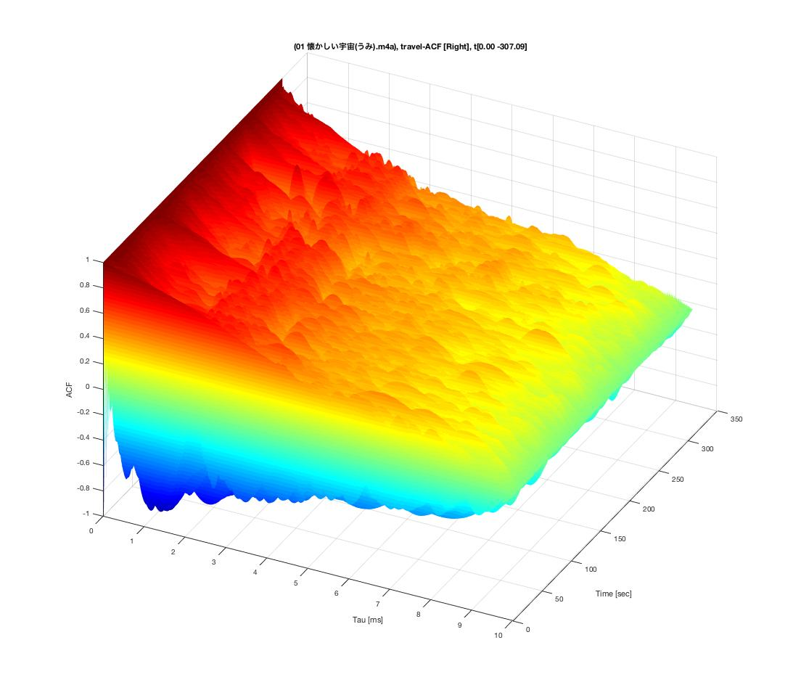
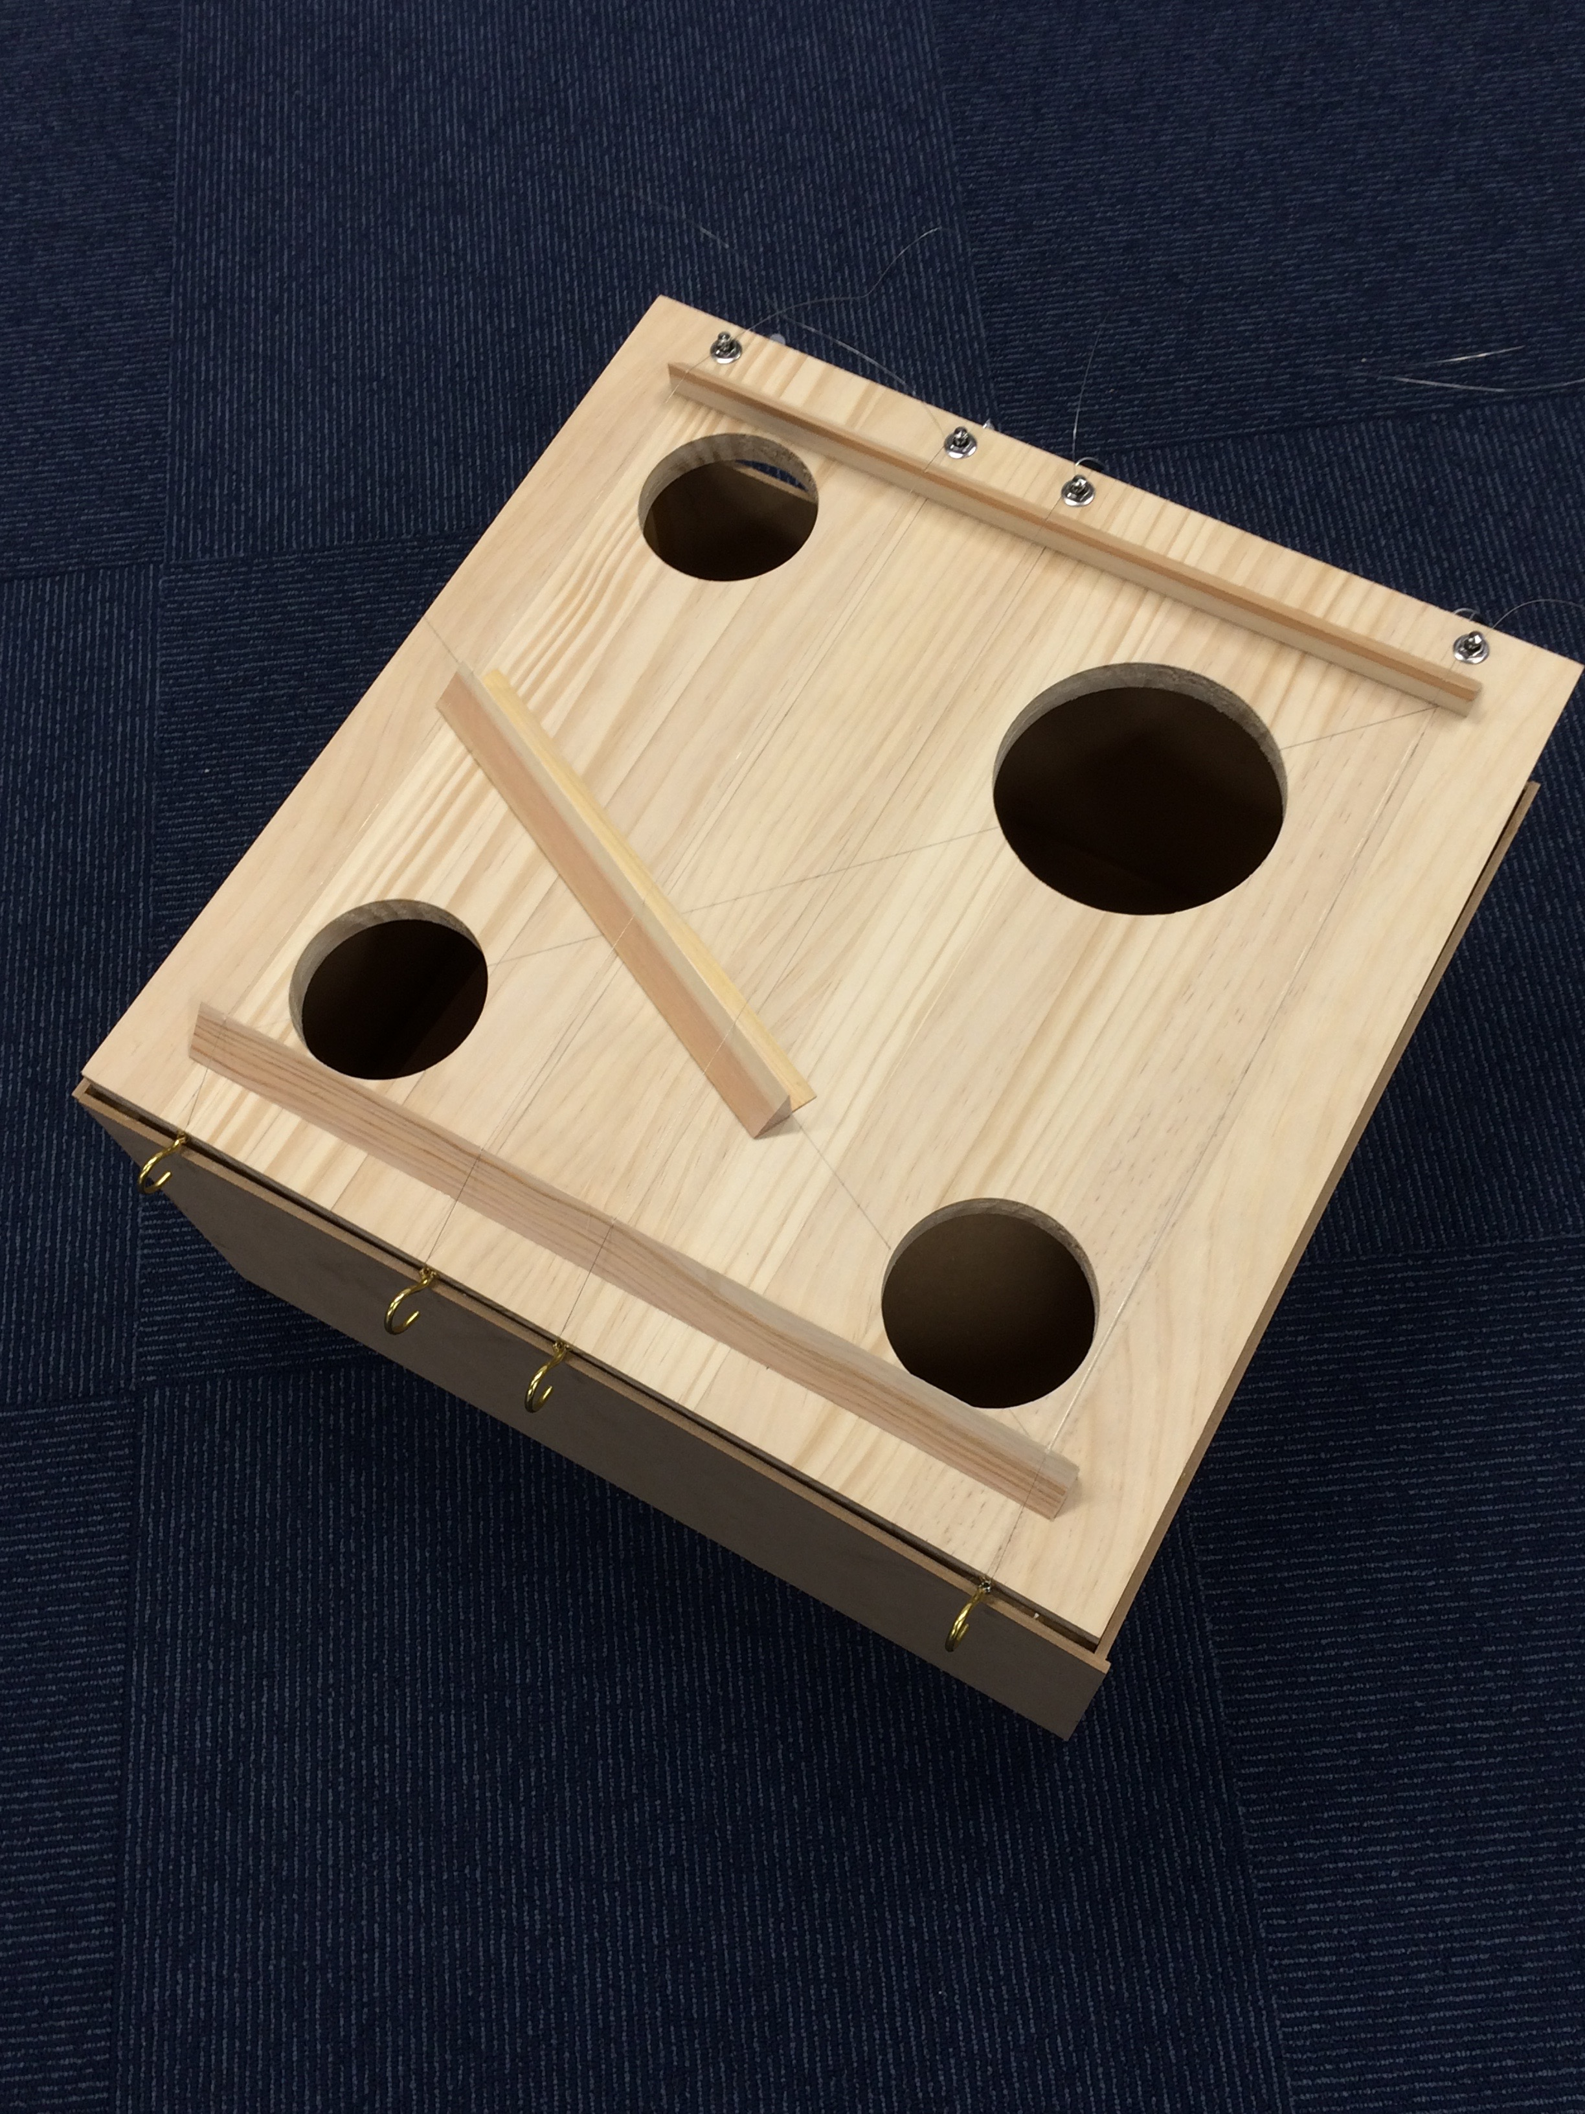
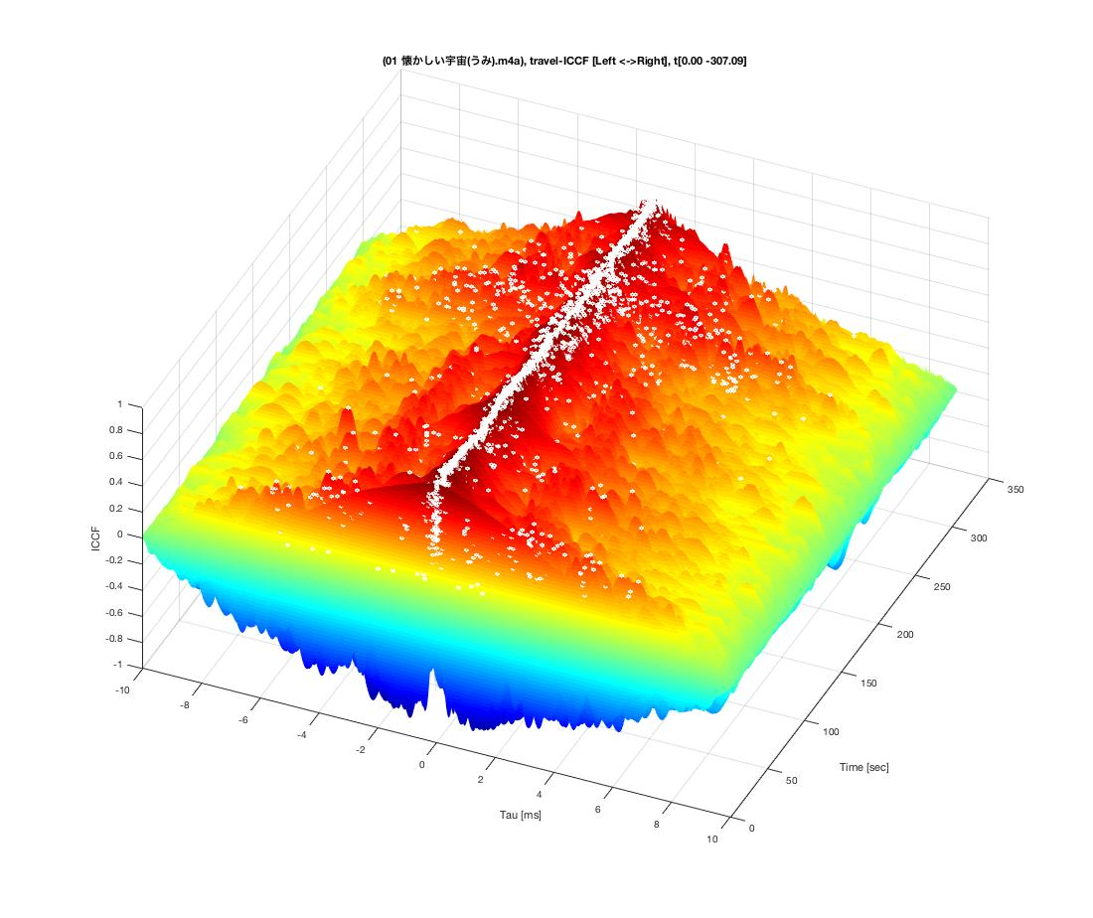
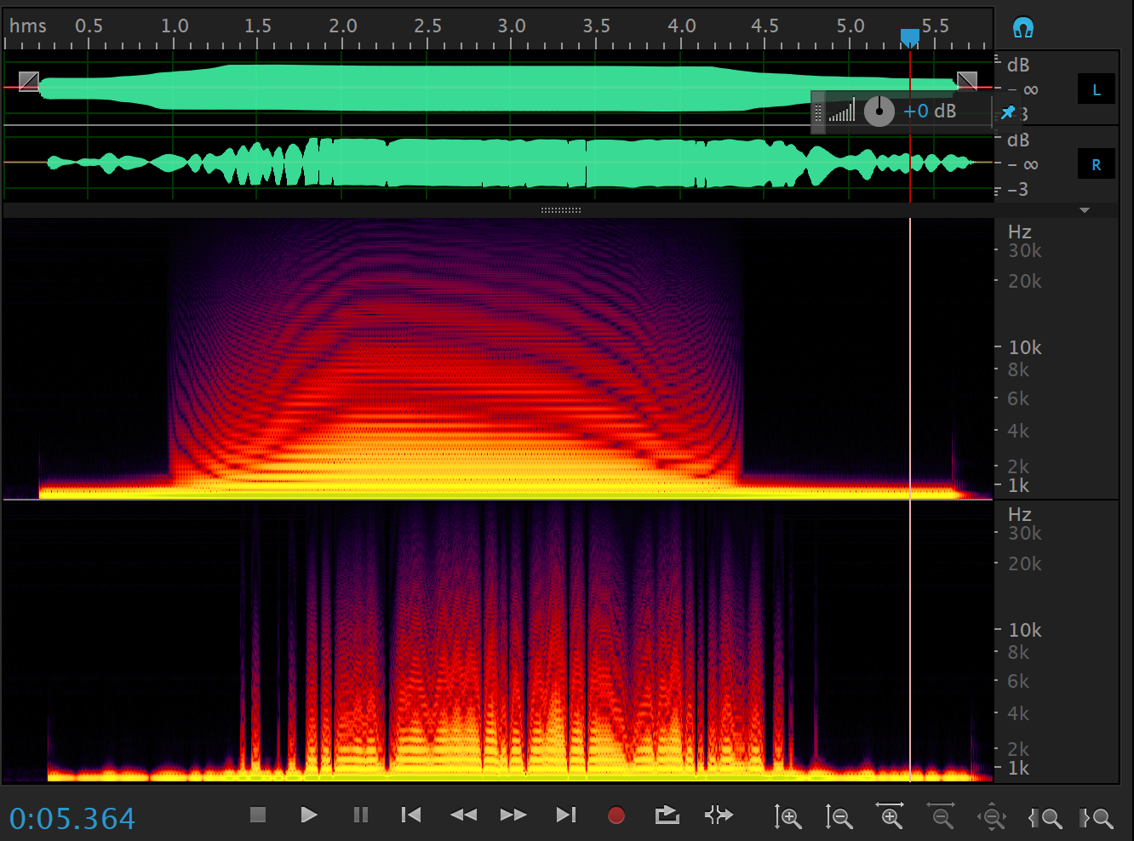
“Project 2: Visualizing The Unseen
—— Sound & Music Research——”
Koji Sato
2025/06/12

Slide 2
“xcor-Analyzer”
（Correlation Function Analysis）
Visualizing the nature of sound and music with a 'Microscope for Sound.'

Slide 3
To reproduce the acoustics of a concert hall designed by Wagner in a hall in Japan, it was first necessary to measure and study its acoustic effects.
The well-known "Correlation Function" from engineering and mathematical physics should be applicable.

Slide 4
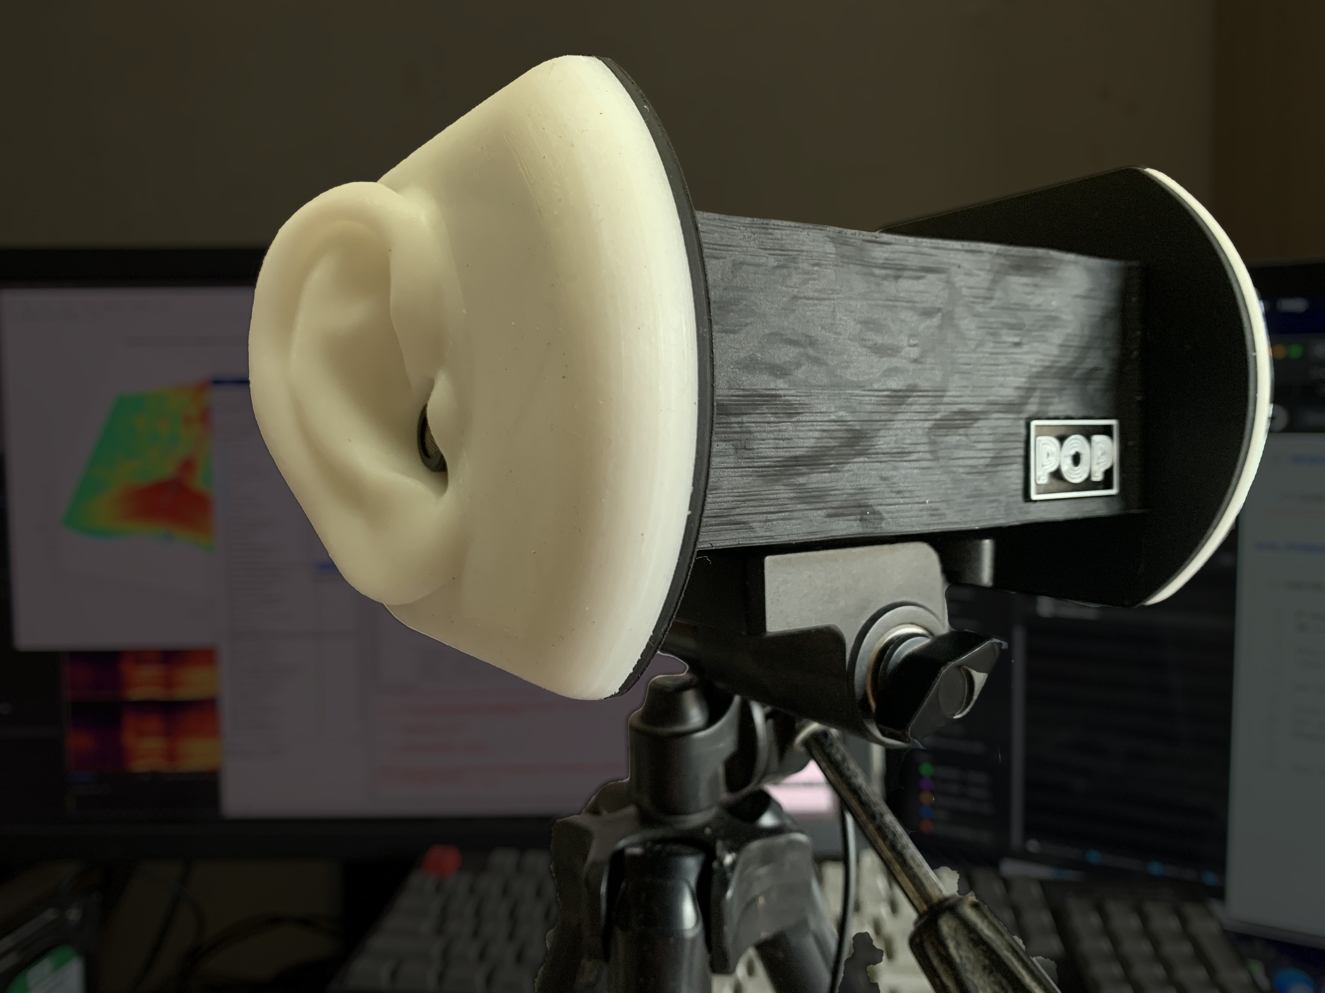
A stereo microphone that mimics both ears exists
known as a "Binaural Microphone."
Using mathematical physics, the "Microscope for Sound" was developed in MATLAB.

Slide 5
Autocorrelation Function
Input from only one channel of a stereo signal.
The peaks in the resulting terrain indicate the frequencies of the sounds being played. Viewed from above, this corresponds to a 'musical score' at the frequency level.
All overtones (harmonics) are visible.

Slide 6
Cross-correlation Function
Input from both channels of a stereo signal.
The peaks in the resulting terrain show the echoes within the studio.
The white dots indicate the relative position of the 'singer' or 'instrument' to the microphone.
The size of the sound source can also be estimated from the spread of the peaks.

Slide 7
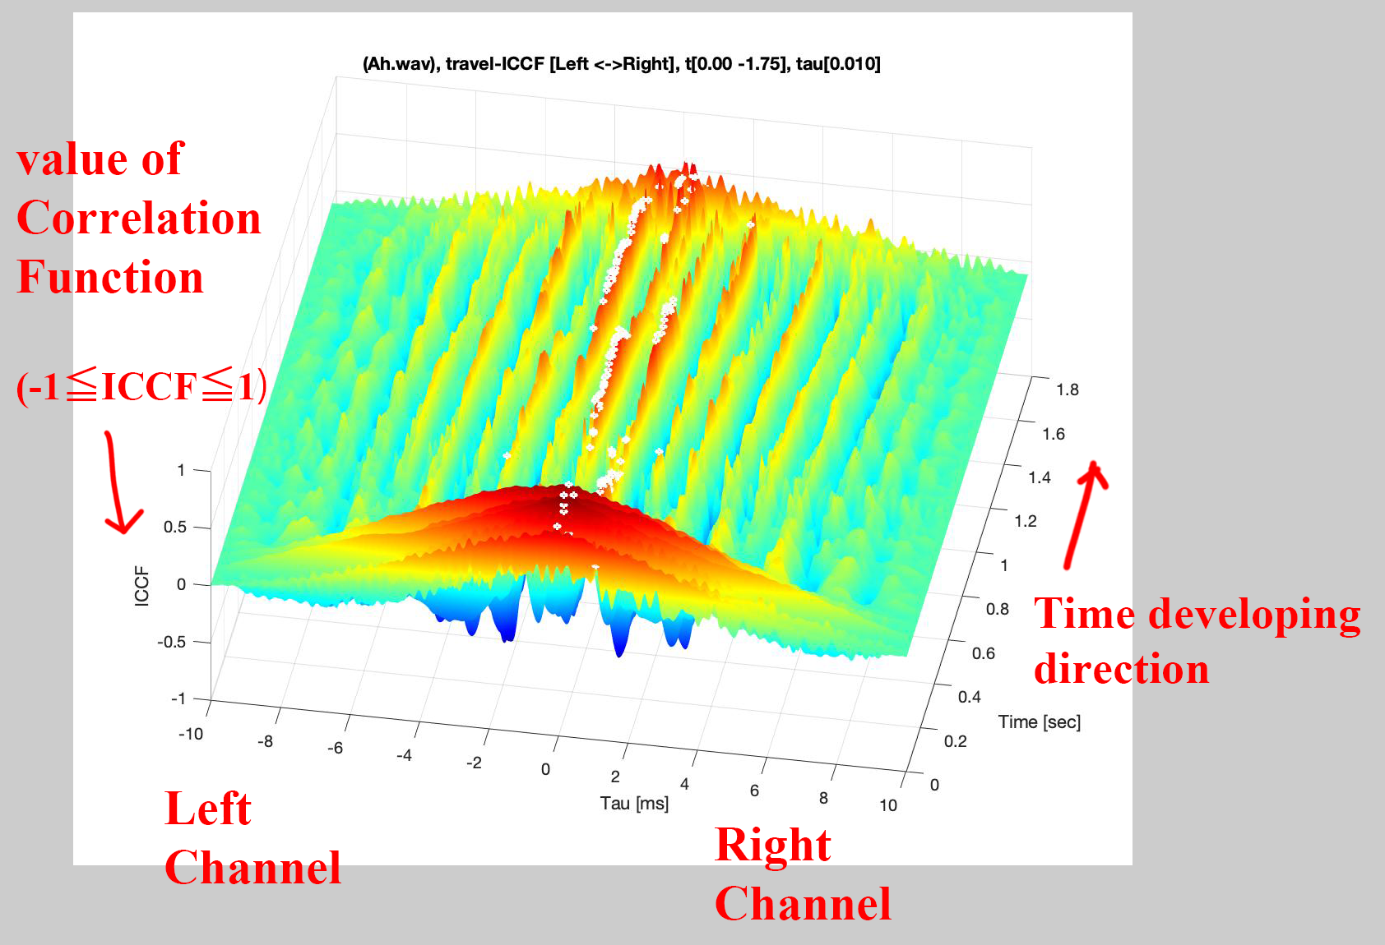
An experiment: Moving in front of the binaural microphone while singing.
The instantaneous sound peaks (white dots) show a time lag moving from +1ms to -1ms, indicating a right-to-left movement.
Multiplying this by the speed of sound reveals a total movement of approximately 68cm while singing.
⇒ The distance of the sound source’s movement can be calculated
from the audio alone.

Slide 8
From only the recorded audio, the environment in which it was recorded (its spacetime) could be quantitatively visualized.
This method can analyze the relationships
between dynamic time-series data,
such as songs, music, and even stock or oil prices.

Slide 9
Paving the Way to Reproduce Wagner's Concert Hall Acoustics in Japan.
By measuring both, differences can be found and compared, which means countermeasures are possible.

Slide 10
https://github.com/renpoo/xcor_Analyzer

Slide 11
Articles:
https://medium.com/@Renpoo
“The Imprinted Collective Knowledge of Humanity in Language: What Generative AI Has Revealed (A Reflection on Generative AI)” https://medium.com/@Renpoo/the-imprinted-collective-knowledge-of-humanity-in-language-what-generative-ai-has-revealed-a-79d4780744d1?sk=6ab71059a3ff0b1c3c697a020e024ef7

